Slide 1
Mobile Price Classification Using Machine Learning
AMGHAR HIND

Slide 2
Develop a Classification Model for determining price range based on features available

Slide 3
Objectives :
Cleaning Data and Feature Selection
Training and Evaluate Model
Save Model for Future Use
File Description :
train.csv : The training set. Features of mobile phone with price range
test.csv : The test set. For Forecasting using the model we are going to train using above train dataset

Slide 4
IMPORT DATA
Python code to import necessary libraries and dataset
Displaying the first few rows of the dataset
Information about the dataset's columns and missing values

Slide 5
Data Fields :
battery_power : Total energy a battery can store in one time measured in mAh
blue : Has bluetooth or not
clock_speed : speed at which microprocessor executes instructions
dual_sim : Has dual sim support or not
fc : Front Camera mega pixels
four_g : Has 4G or not
int_memory : Internal Memory in Gigabytes
m_dep : Mobile Depth in cm
mobile_wt : Weight of mobile phone
n_cores : Number of cores of processor
pc : Primary Camera mega pixels
px_height : Pixel Resolution Height
px_width : Pixel Resolution Width
ram : Random Access Memory in Mega Bytes
sc_h : Screen Height of mobile in cm
sc_w : Screen Width of mobile in cm
talk_time : longest time that a single battery charge will last when you are
three_g : Has 3G or not
touch_screen : Has touch screen or not
wifi : Has wifi or not
price_range : This is the target variable with value of 0(low cost), 1(medium cost), 2(high cost) and 3(very high cost)

Slide 6
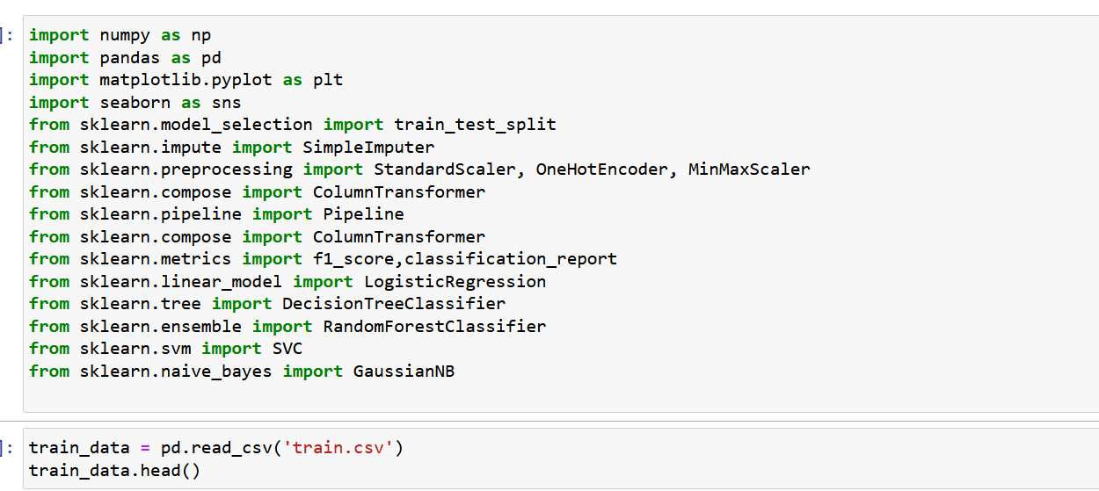
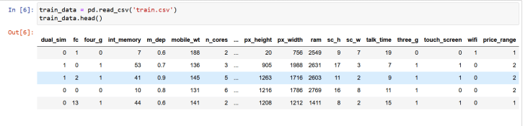
IMPORT NECESSARY LIBRARIES
DISPLAYING THE FIRST FEW ROWS OF THE DATASET

Slide 7
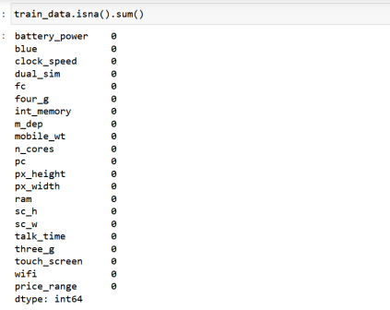
MISSING VALUES

Slide 8
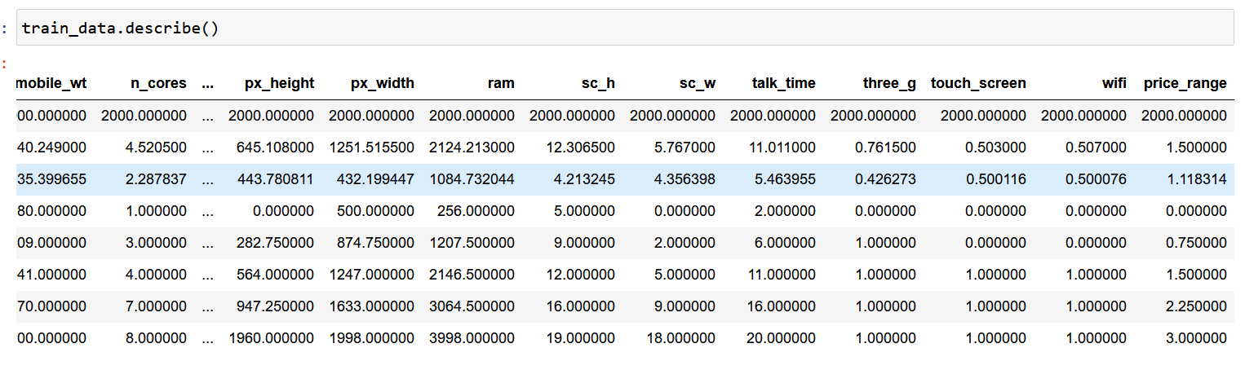
INFORMATION ABOUT THE DATASET

Slide 9
EXPLORATORY DATA ANALYSIS (EDA)
Visualization of distributions and relationships between features
Histograms, box plots, and count plots for numerical and categorical features
Observations from the EDA process

Slide 10

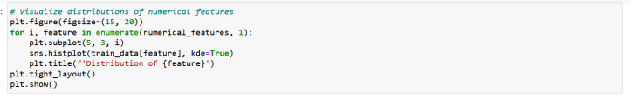
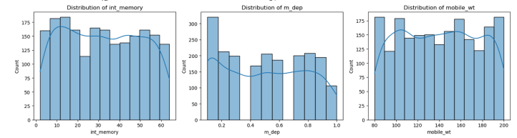
VISUALIZE DISTRIBUTIONS OF FEATURES
VISUALIZE DISTRIBUTIONS OF NUMERICAL FEATURES

Slide 11
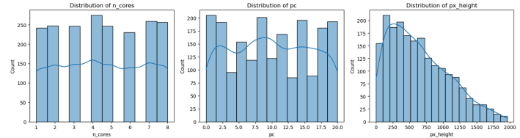
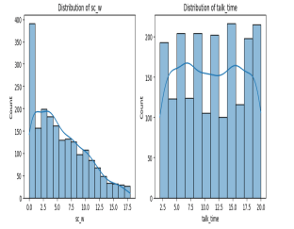
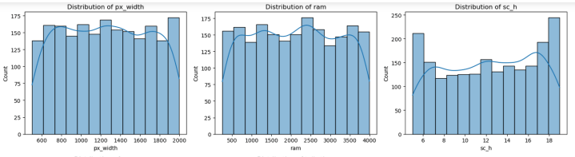
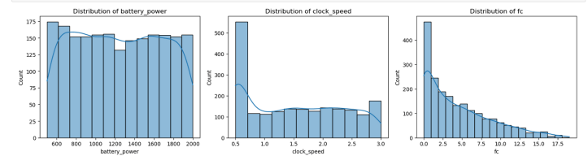

Slide 12
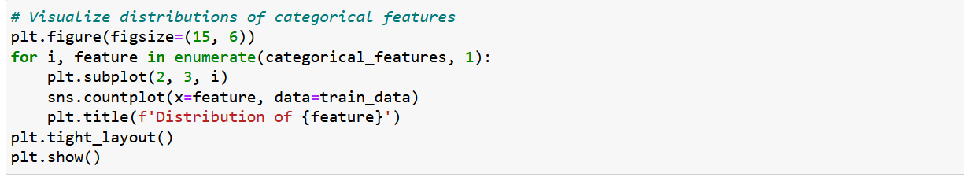
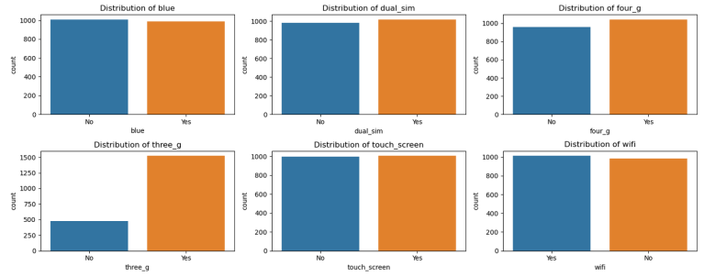
VISUALIZE DISTRIBUTIONS OF CATEGORICAL FEATURES

Slide 13
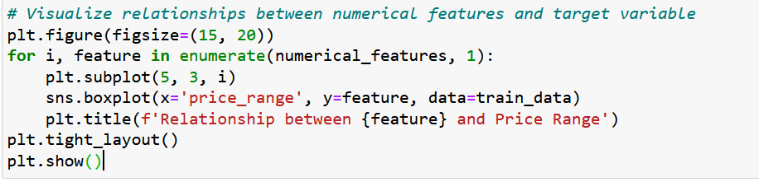
VISUALIZE RELATIONSHIPS BETWEEN NUMERICAL FEATURES AND TARGET VARIABLE

Slide 14
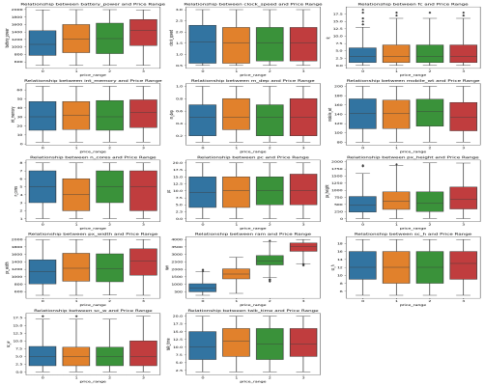
VISUALIZE RELATIONSHIPS BETWEEN NUMERICAL FEATURES AND TARGET VARIABLE

Slide 15
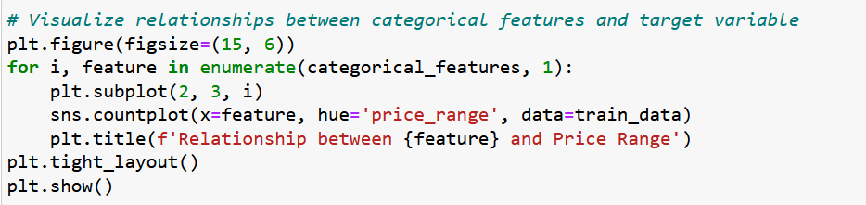
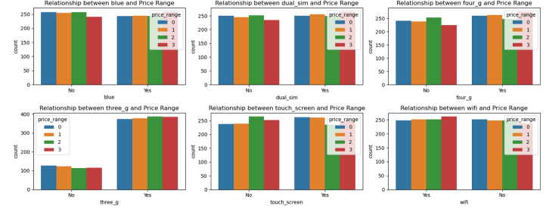
VISUALIZE RELATIONSHIPS BETWEEN CATEGORICAL FEATURES AND TARGET VARIABLE

Slide 16
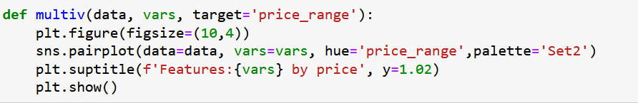
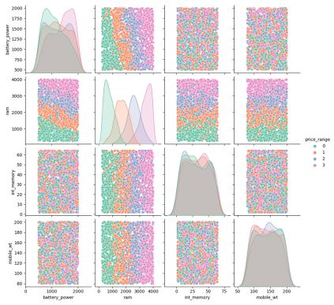
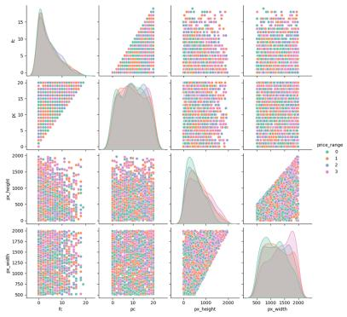
VISUALIZE RELATIONSHIPS BETWEEN FEATURES

Slide 17
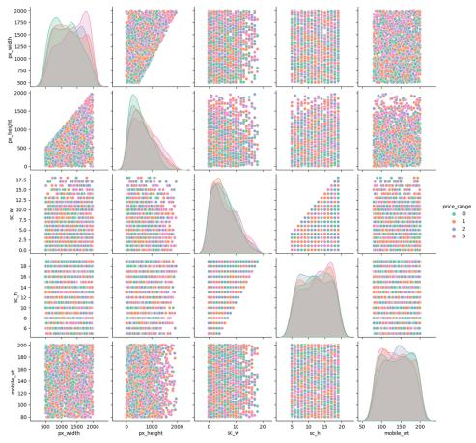
VISUALIZE RELATIONSHIPS BETWEEN FEATURES

Slide 18
Observations
A higher battery power tends to be associated with a more advanced class of mobile device.
Although mobile weight does have an impact, its influence on the device class is relatively smaller compared to other factors.
Pixel width (px_width) is a significant factor in determining the class of mobile devices.
RAM (ram) is a critical determinant in the classification of mobile devices.
The majority of mobile devices support 3G connectivity.
Pixel height and width (px_height and px_width) are correlated with the class of mobile devices.
Screen height and width (sc_h and sc_w) also show a correlation with the class of mobile devices.
OBSERVATIONS

Slide 19
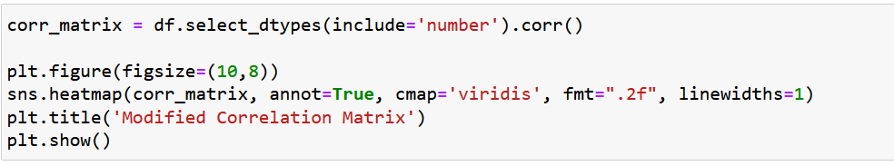
CORRELATION ANALYSIS

Slide 20
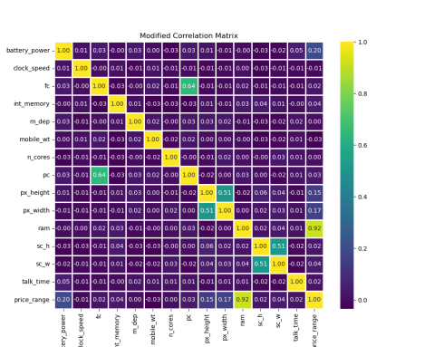
CORRELATION ANALYSIS
Observations
exists a correlation between (ram) and price_range.
exists a correlation between the resolutions of the primary camera (pc) and the front camera (fc).

Slide 21
FEATURE ENGINEERING
Preprocessing steps for feature transformation and scaling
Code snippet demonstrating the use of pipelines and transformers
Splitting the dataset into training and validation sets
.

Slide 22
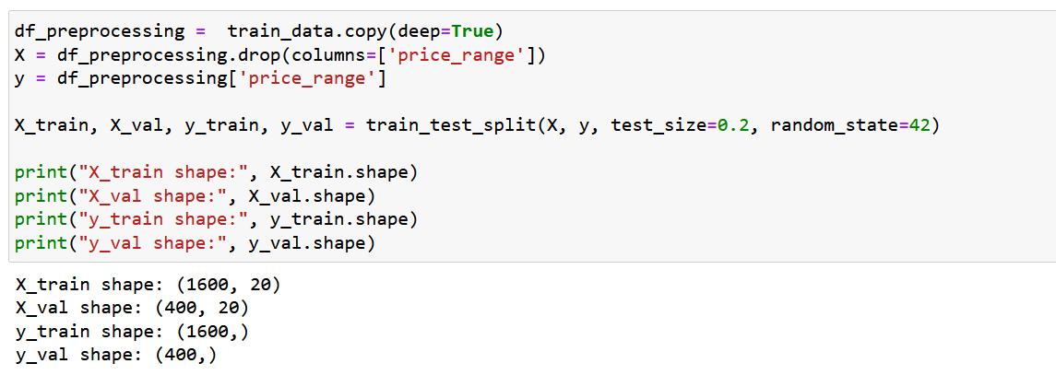
SPLITTING THE DATASET INTO TRAINING AND VALIDATION SETS

Slide 23
SPLITTING THE DATASET INTO TRAINING AND VALIDATION SETS

Slide 24
SPLITTING THE DATASET INTO TRAINING AND VALIDATION SETS
The independent features are extracted into `X`, excluding the target variable 'price_range', while the target variable itself is assigned to `y`.
The dataset is then split into training and validation sets using the `train_test_split` function from scikit-learn, with a test size of 20% and a random state of 42 for reproducibility.
After the split, the shapes of the training and validation sets for both features and target variables are printed to provide an overview of the dataset partitioning.
The training set (`X_train` and `y_train`) contains 1600 samples with 20 features each, while the validation set (`X_val` and `y_val`) contains 400 samples with the same number of features. This preprocessing step prepares the data for subsequent machine learning model training and evaluation.
.

Slide 25
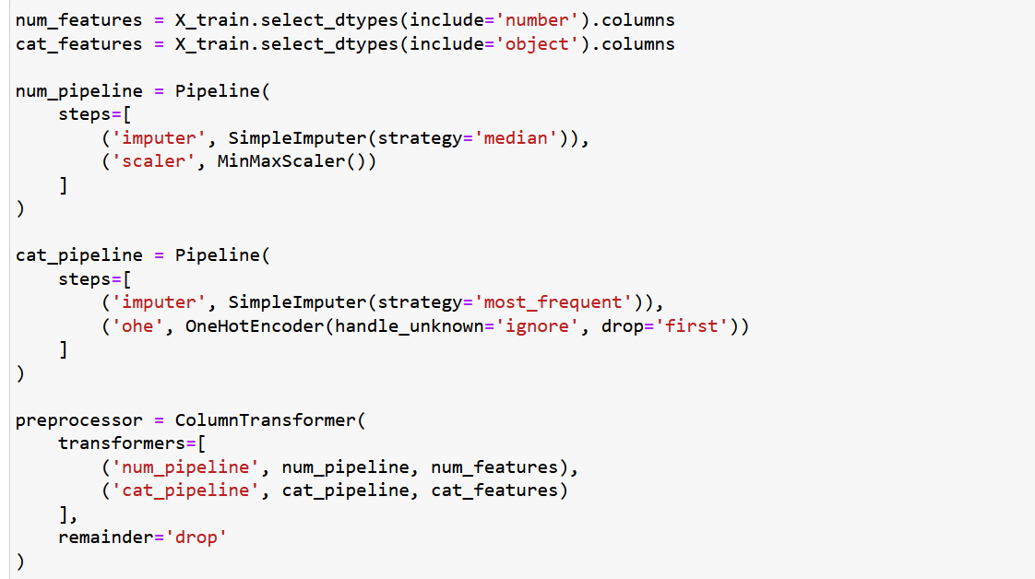
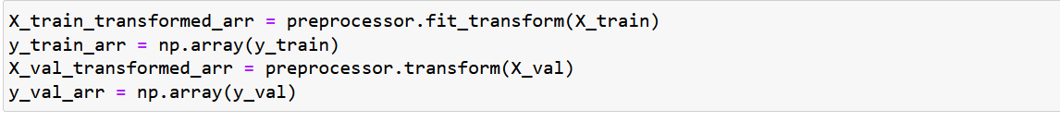
DATA PREPROCESSING PIPELINE

Slide 26
DATA PREPROCESSING PIPELINE
The provided code snippet establishes a comprehensive data preprocessing pipeline for machine learning tasks.
It begins by categorizing features into numerical and categorical types, acknowledging the need for distinct treatment.
Two separate pipelines are then constructed: one for numerical features and another for categorical features. The numerical pipeline employs SimpleImputer to handle missing values via median strategy and scales features using MinMaxScaler for normalization. Similarly, the categorical pipeline handles missing values with SimpleImputer using the most frequent strategy and performs one-hot encoding using OneHotEncoder for categorical feature transformation. These pipelines are integrated into a ColumnTransformer to manage different transformations for each feature type efficiently. Finally, the training and validation datasets undergo transformation using the preprocessor, resulting in numpy arrays ready for model training and evaluation. This systematic approach ensures data consistency and prepares the dataset effectively for machine learning algorithms.
.

Slide 27
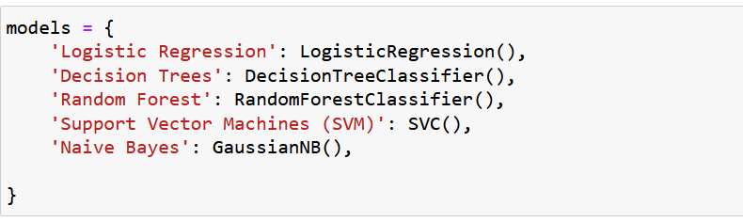
MODELING

Slide 28
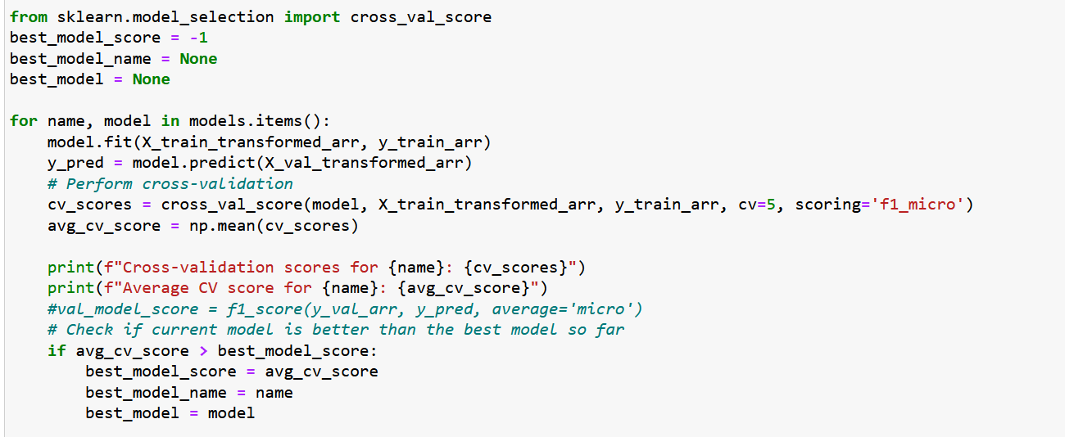
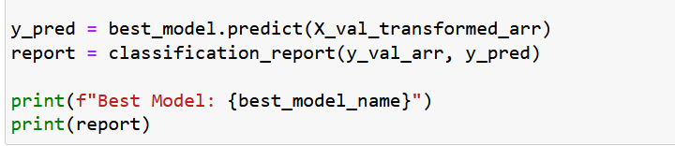
MODELING

Slide 29
MODELING
First defines a dictionary called `models`, which includes several machine learning models:
1. **Logistic Regression**: A linear classification model that predicts the probability of a categorical target variable.
2. **Decision Trees**: A tree-based model that partitions the feature space into regions and assigns a label to each region.
3. **Random Forest**: An ensemble model that aggregates predictions from multiple decision trees to improve accuracy and reduce overfitting.
4. **Support Vector Machines (SVM)**: A model that finds the hyperplane that best separates different classes in the feature space.
5. **Naive Bayes**: A probabilistic classifier based on Bayes' theorem, assuming independence between features.
The code then iterates over each model in the `models` dictionary, fitting it to the training data (`X_train_transformed_arr` and `y_train_arr`). After fitting, each model's performance is
evaluated using cross-validation with a 5-fold scheme.
The average F1 score (micro) across all folds is computed for each model and printed.
.

Slide 30
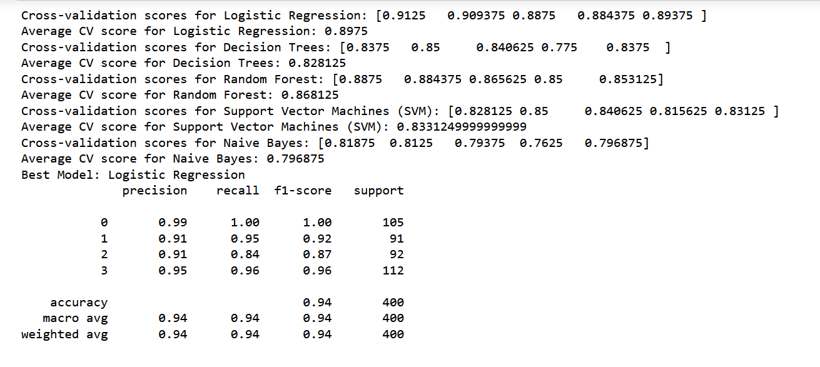
MODEL EVALUATION

Slide 31
MODEL EVALUATION
The result provides the following information:
Cross-validation scores: For each model, the F1 scores obtained from cross-validation are printed, indicating how well each model generalizes to unseen data.
Average CV score: The average F1 score across all folds is computed and printed for each model, providing an overall assessment of its performance.
Best Model: The model with the highest average cross-validation score is identified and printed as the best model.
Classification Report: The best model is used to make predictions on the validation data (X_val_transformed_arr), and a classification report is generated and printed. This report includes metrics such as precision, recall, F1-score, and support for each class, as well as overall accuracy metrics.
In this case, the best model identified is Logistic Regression, with an average cross-validation F1-score of 0.8975. On the validation dataset, this model achieves an accuracy of 94%, as indicated by the classification report.
.

Slide 32
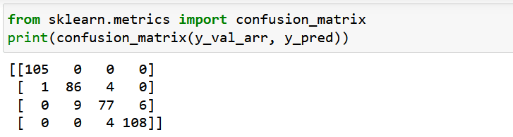
THE CONFUSION MATRIX

Slide 33
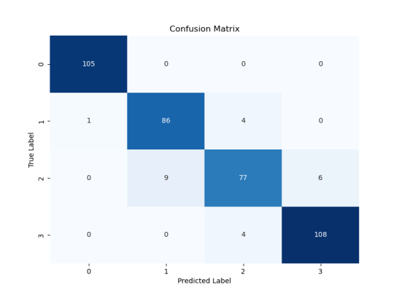
THE CONFUSION MATRIX
The provided confusion matrix summarizes the performance of a classification model on a validation dataset.
It indicates that the model correctly predicted the majority of instances for each class, with high numbers of true positives across all classes.
However, there are also instances of misclassification, with some false positives and false negatives present.

Slide 34
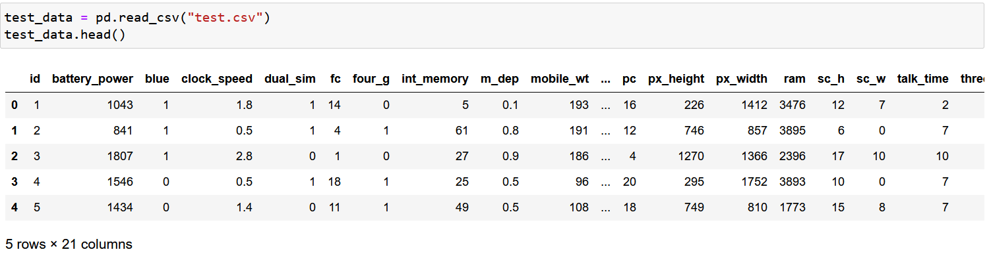
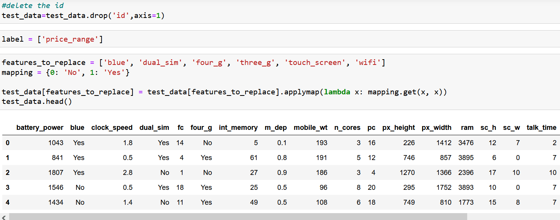
PREDICTIONS ON TEST DATA

Slide 35
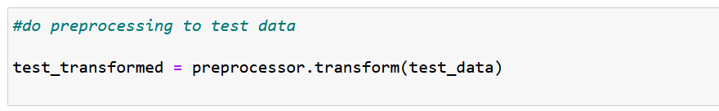
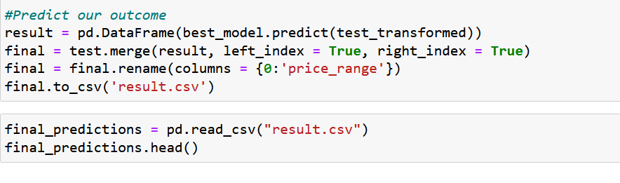
PREDICTIONS ON TEST DATA

Slide 36
PREDICTIONS ON TEST DATA
Initially, the test data is loaded and the 'id' column is removed to prepare it for prediction. Preprocessing steps are then applied to the test data to ensure consistency with the training data.
Subsequently, the preprocessed test data is used to predict the 'price_range' using the best performing model identified during training.
The predicted outcomes are merged back into the original test DataFrame, and the results are saved to a CSV file for further analysis.
This comprehensive approach enables the efficient deployment of the machine learning model to make predictions on unseen data, facilitating decision-making processes in real-world applications.
.

Slide 37
Model Serialization and Deployment

Slide 38
@APP.ROUTE('/PREDICT', METHODS=['POST'])
DEF PREDICT():
DATA = REQUEST.JSON
FEATURES = TRAIN_DATA.COLUMNS
PREDICTION = BEST_MODEL.PREDICT(FEATURES)
RETURN JSONIFY({'PREDICTION': PREDICTION.TOLIST()})
RUNNING FLASK APP:
IF __NAME__ == '__MAIN__':
APP.RUN(DEBUG=TRUE)

Slide 39
Model Serialization with Joblib
Serialization process using joblib to save the best trained model.
joblib.dump(best_model, 'best_model.pkl')
Confirmation message indicating successful serialization.
print("Model has been serialized and saved as 'best_model.pkl'")
.

Slide 40
Model Deployment with Flask
Deploying the serialized model using Flask.
Importing necessary libraries: from flask import Flask, request, jsonify
Loading the serialized model: best_model = joblib.load('best_model.pkl')
Initializing Flask app: app = Flask(__name__)
Defining prediction endpoint /predict
.

Slide 41
Model Deployment Process
Serialization of the model ensures that it can be stored and reused without retraining.
Flask framework is utilized to deploy the serialized model as a web service.
Prediction endpoint /predict is defined to handle incoming requests and return predictions.
The deployed model can be accessed via HTTP POST requests, making it accessible for integration into other applications.

Slide 42
Sample Prediction Request
input data in JSON format.
Sending a POST request to the Flask app with the sample input data.
Printing the prediction received from the Flask app.
Deployment Considerations
Ensure that the Flask app is running on the appropriate server.
Monitor server resources to handle incoming prediction requests efficiently.
Implement security measures to protect the deployed model from unauthorized access.
Regularly update and maintain the deployed model to ensure optimal performance and reliability.

Slide 43
Conclusion
Serialization and deployment enable the model to be used in real-world
applications.
Flask provides a simple and effective framework for deploying machine
learning models as web services.
Continuous monitoring and maintenance are essential for successful model deployment and integration.

Slide 44
Thank you

